Slide 2
Introduction
Globally, alcohol is the cause of 50% of all deaths due to liver disease
Various forms of alcohol-associated liver disease (ALD) will develop in approximately 35% of patients with alcohol use disorder.
Global incidence is probably increasing, especially among young adults (in their 20s and 30s) and women.
Incidence has increased during the coronavirus disease 2019 pandemic.

Slide 3
Introduction
Most patients with ALD receive a diagnosis at an advanced stage
A severe clinical profile may develop in patients with underlying ALD and active drinking, characterized by an abrupt onset of jaundice, malaise, decompensated liver disease, and coagulopathy, an entity called alcohol-associated hepatitis.
In its severe forms, alcohol-associated hepatitis is associated with bacterial infections and the development of acute-on-chronic liver failure, multiorgan failure, and high short-term mortality (20 to 50% at 3 months)

Slide 4
Predisposing Factors
Many patients have only mild forms
Most patients presenting with alcohol-associated hepatitis have a history of prolonged and heavy alcohol use, whether the total amount or pattern of alcohol consumption plays a role remains unknown

Slide 5
Predisposing Factors
Sex differences have been observed in alcohol-associated hepatitis.
Both in the manifestations and severity of liver disease and in the prevalence and severity of alcohol use disorder and relapse potential.
Women are more susceptible to alcohol injury and cirrhosis
Hispanic persons are predisposed to the development of alcohol-associated hepatitis 3 (PNAPL3) influence disease severity among persons with alcohol-associated hepatitis

Slide 6
Predisposing Factors
Coffee consumption and polymorphism in the gene encoding hydroxysteroid 17-beta dehydrogenase 13 (HSD17B13) have shown a protective role

Slide 7
Predisposing Factors
Earlier studies that focused on animal models proposed central role for TNFα
Subsequent attempts to block this molecule in patients with alcohol associated hepatitis were unsuccessful and were associated with severe and life-threatening infections, probably due to its role in liver regeneration and protection against bacterial infections

Slide 8
Mechanism
Mechanisms of alcohol- associated hepatitis:
Microbiome
Proinflammatory signals
Factors leading to poor hepatocyte differentiation and function.

Slide 9
Pathogenesis
The liver is the main site to metabolize alcohol into acetaldehyde
Injured hepatocytes release danger-associated molecular patterns and trigger inflammatory responses by activating the inflammasome–caspase-1 complex.
Excessive consumption of alcohol increases gut permeability by disrupting the tight junctions in the intestinal epithelial cells and profound changes in the microbiome, increased pathogenic bacteria (Enterococcus faecalis) and immunogenic fungi.

Slide 10
Pathogenesis
These processes culminate in the activation of fibrogenic cell types that accumulate extracellular matrix around hepatocytes and sinusoidal cells, forming a “chickenwire” pattern and favoring the development of portal hypertension.

Slide 11
Pathogenesis
The livers from patients with severe forms are characterized by massive ductular reaction and hepatocyte dedifferentiation into a cholangiocyte-like phenotype.

Slide 15
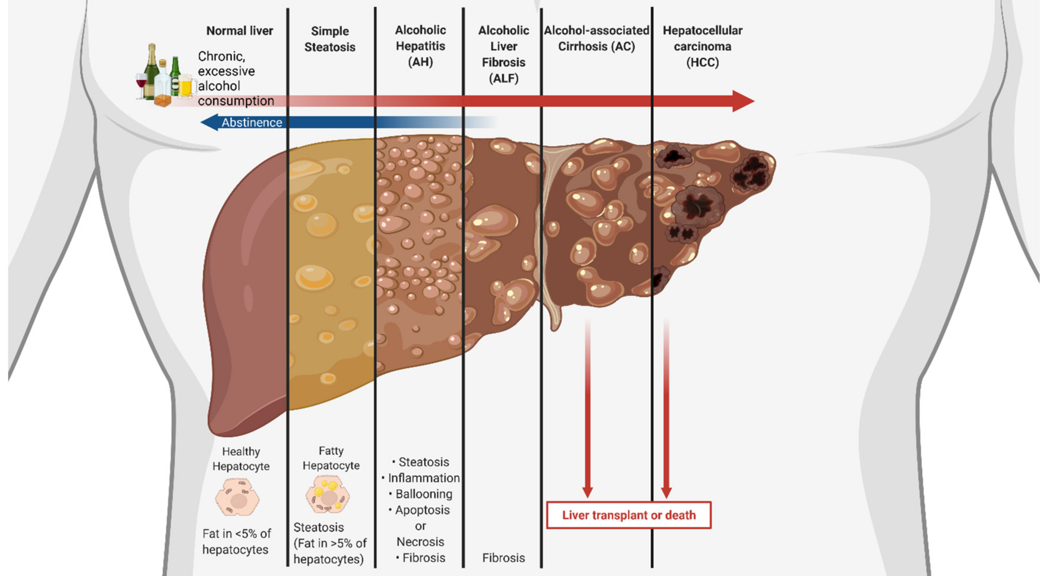

Slide 16
Diagnosis
NIAAA-funded Alcoholic Hepatitis Consortia proposed criteria to clinically define alcohol-associated hepatitis:
Onset of jaundice within the previous 8 weeks
Ongoing consumption of more than 3 drinks (40 g)/day for women and 4 drinks (50 to 60 g)/day for men for 6 months or more, with less than 60 days of abstinence before the onset of jaundice
Total serum bilirubin >3 mg/dl, AST >50 IU/L, AST /ALT >1.5, with both values less than 400 IU/L
Ruling out of other liver diseases such as drug-induced liver injury and ischemic hepatitis.

Slide 18
Diagnosis
Imaging should rule out biliary obstruction, and an extensive workup for other causes.
Liver biopsy through a trans jugular route is recommended in patients with factors that confound diagnosis

Slide 21
Diagnosis
Alcohol-associated hepatitis is characterized by features of alcohol-related steatohepatitis (ballooned hepatocytes, Mallory–Denk bodies, and neutrophil infiltration), ductular reaction, bilirubinostasis, and pericellular and sinusoidal fibrosis (chickenwire appearance).
Many of these features do not differ from those described in nonalcoholic steatohepatitis (NASH)
It is difficult to differentiate between the two entities on the basis of histologic findings alcohol-associated hepatitis typically have more megamitochondria, pericellular fibrosis, macrovesicular steatosis, and bilirubinostasis

Slide 22
Prognosis
Liver biopsy can provide prognostic information.
The AHHS includes four histologic features:
Presence of bridging fibrosis or cirrhosis
Hepatocellular, canalicular, or ductular bilirubinostasis
Severe neutrophil infiltration
Megamitochondria
Independently predict 90-day mortality.

Slide 23
Prognosis
The SALVE¹ described a semiquantitative score for alcohol associated hepatitis. This scoring systems, the presence of fully developed cirrhosis confers a bad prognosis

Slide 24
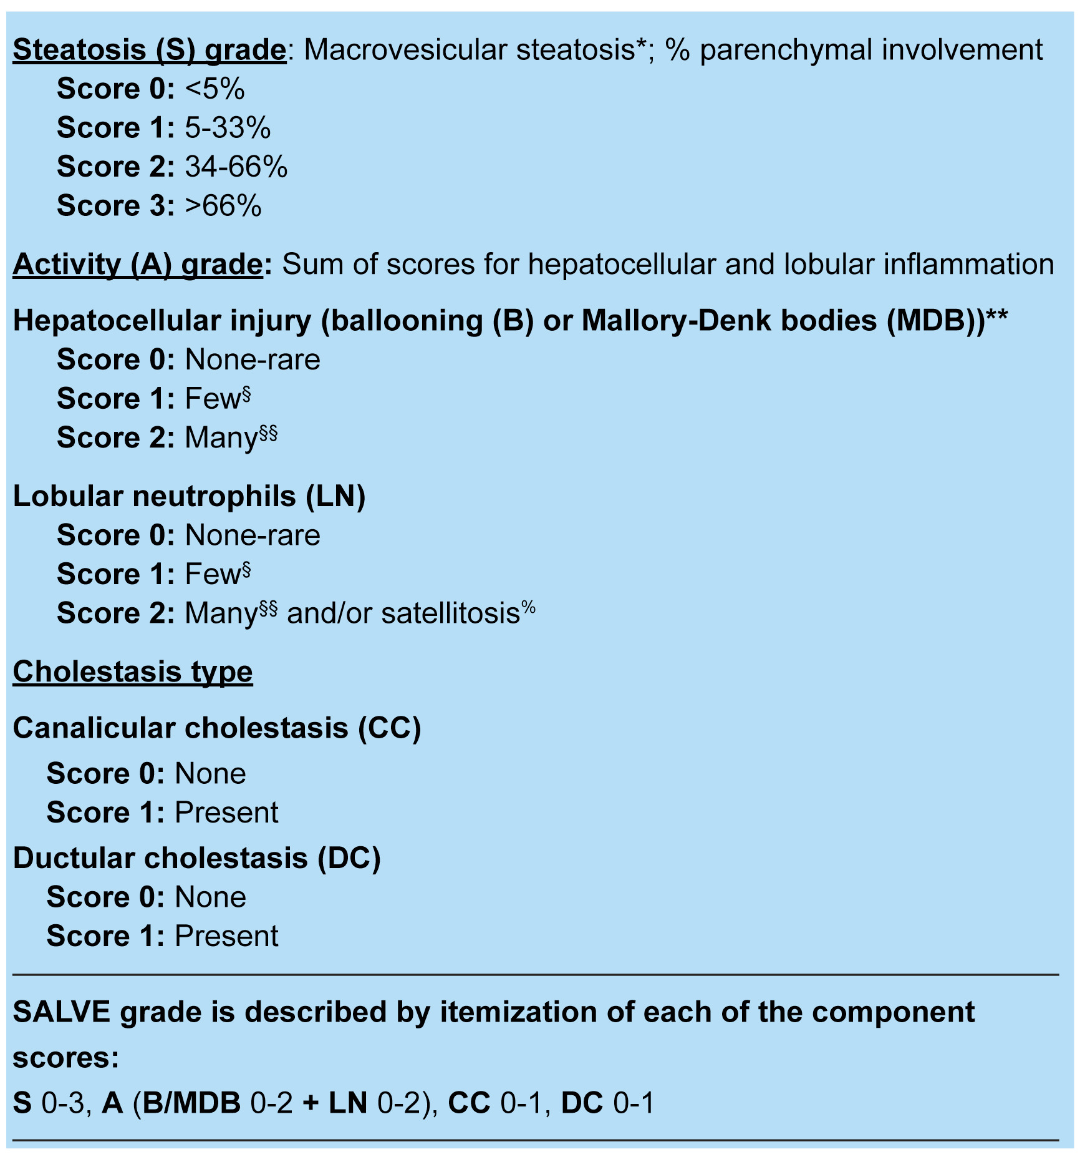
SALVE score

Slide 25
Prognosis
Because liver biopsy is costly and invasive
Serum keratin-18 fragments have been shown to correlate with histologic severity and 90-day mortality and can be useful to predict response to glucocorticoid therapy.
Other potential biomarkers include circulating extracellular vesicles and microRNA.

Slide 26
Prognosis
At presentation, patients are jaundiced and often have ascites and edema.
Some patients present with severe caloric malnutrition and sarcopenia.
Hepatic encephalopathy confers a particularly poor prognosis.
Patients can present with tender hepatomegaly, and because there is an increase in portal hypertension this can lead to variceal bleeding

Slide 27
Prognosis
Many patients present with signs of SIRS (low-grade fever and neutrophilia), in some cases an infection cannot be diagnosed, suggests a sterile origin.
Most bacterial infections can be controlled with broad spectrum AB, in-hospital incident infections have a bad prognosis and are often caused by MDR bacteria, leading to AKI and acute-on-chronic liver failure.
All patients at admission and after any signs of SIRS or clinical deterioration should be evaluated for infections.
The use of biomarkers such as procalcitonin is potentially helpful to differentiate sterile SIRS from infection-associated SIRS.
Infections in patients receiving glucocorticoids have a worse prognosis than those in patients not receiving glucocorticoids.

Slide 28
Prognosis
The mortality associated with an episode of alcohol-associated hepatitis warranting hospitalization is approximately 20 to 50% at 90 days.
MELD score has been shown to be the best static scoring system at a global level, and current guidelines recommend its use for patient risk stratification.
Lille score is a dynamic score that is useful to assess prognosis and to define non response to glucocorticoids; it is calculated at day 7, but it may be alternatively calculated at day 4.

Slide 29
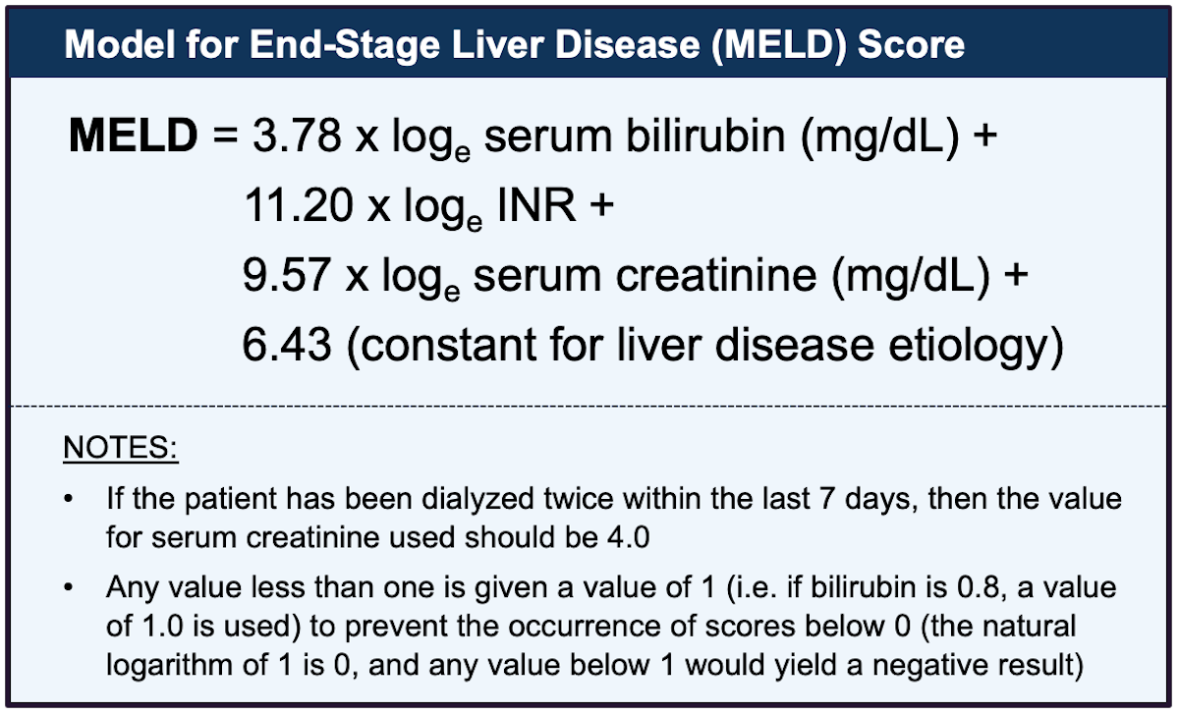

Slide 30
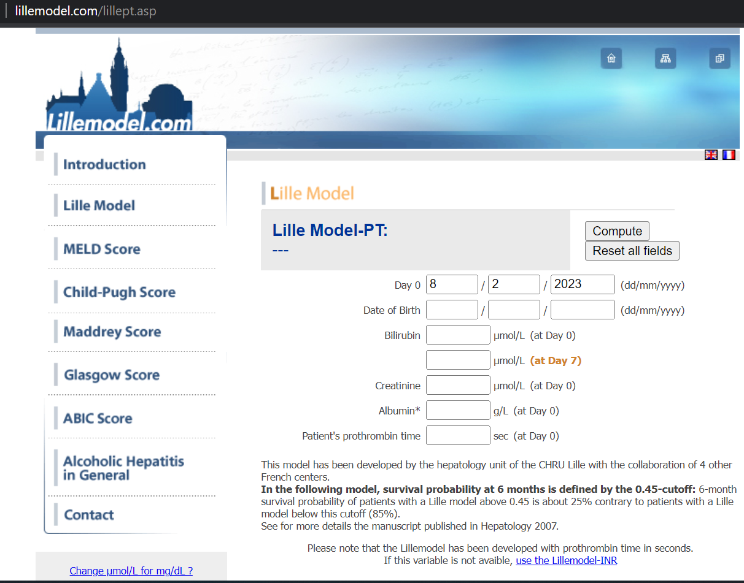

Slide 31
Prognosis
The main factor influencing long-term prognosis after an episode of alcohol-associated hepatitis is prolonged alcohol abstinence.
Alcohol relapse is frequent after an episode of alcohol associated hepatitis, even among who have undergone LT.
post-transplantation alcohol relapse among recipients with ALD ranges from 15 to 50%.
at 5 years after LT, 16.3% of the participants had a relapse with any alcohol use and 8.2% had a relapse with high-dose drinking
The identification of underlying psychiatric conditions (depression or PTSD) and early referral to addiction programs are highly recommended.

Slide 32
Medical Management
The use of alcohol anti craving drugs has not been rigorously tested in the context of alcohol associated hepatitis.
Disulfiram is contraindicated
Baclofen is probably safe in patients with advanced ALD.
Acamprosate should be used cautiously in patients with renal failure
.

Slide 33
Medical Management
Naltrexone should be avoided in patients with decompensated cirrhosis and profound liver dysfunction or concomitant opioid use, patients with moderate alcohol-associated hepatitis may be candidates for this drug.
Topiramate should be avoided if hepatic encephalopathy is present
Gabapentin may be a good option if there is concomitant chronic pain
Varenicline are used off-label, and further studies are needed.

Slide 34
Medical Management
Initiation of addiction therapy during inpatient treatment should be considered as a quality indicator in the management protocol of hospitalized patients with alcohol-associated hepatitis

Slide 35
Medical Management
Patients with ALD who receive treatment for alcohol use disorder have lower progression rates than those who do not
Long-term abstinence is the main goal of the treatment.

Slide 36
Medical Management
Glucocorticoids improved 30-day survival among patients with MELD scores of more than 20, with maximum benefit (defined as ≥20% survival benefit) at MELD scores of 25 to 39
There is enough evidence to show the futility of pentoxifylline.
Some promising results have been shown by adding N-acetylcysteine (a powerful antioxidant) to prednisolone.
The combination improved 1-month survival and reduced the incidence of infections.

Slide 37
Medical Management
It is important to assess the nutritional status
Usual goals for enteral nutrition:
35 to 40 kcal/kg/day with 1.5 g/kg/day of protein

Slide 38
Medical Management
Because infections are common, they should be actively ruled out and treated.
In the STOPAH trial, 12.5% of the patients had an infection at baseline, 23.0% during treatment, and 8.2% after treatment.
Early detection and treatment of infection may reduce the associated mortality.
Controlled infections are not contraindications to the use of glucocorticoids.

Slide 39
Medical Management
Fungal infections are common in patients with severe alcohol-associated hepatitis (with an incidence of up to 16%) and carry a high risk of death.
Fungal infections are frequently underdiagnosed.
Younger age, higher MELD score, glucocorticoid therapy are independently associated with invasive fungal infection.

Slide 40
Medical Management
Acute kidney injury occurs frequently, is present in up to a third of the patients with severe alcohol-associated hepatitis, and is associated with an increase in 90-day mortality
The use of albumin and vasoconstrictors may be indicated if criteria for hepatorenal syndrome are met.
Renal-replacement therapy could be indicated, although its use is hampered by concerns of futility in patients who are not deemed to be candidates for transplantation.

Slide 42
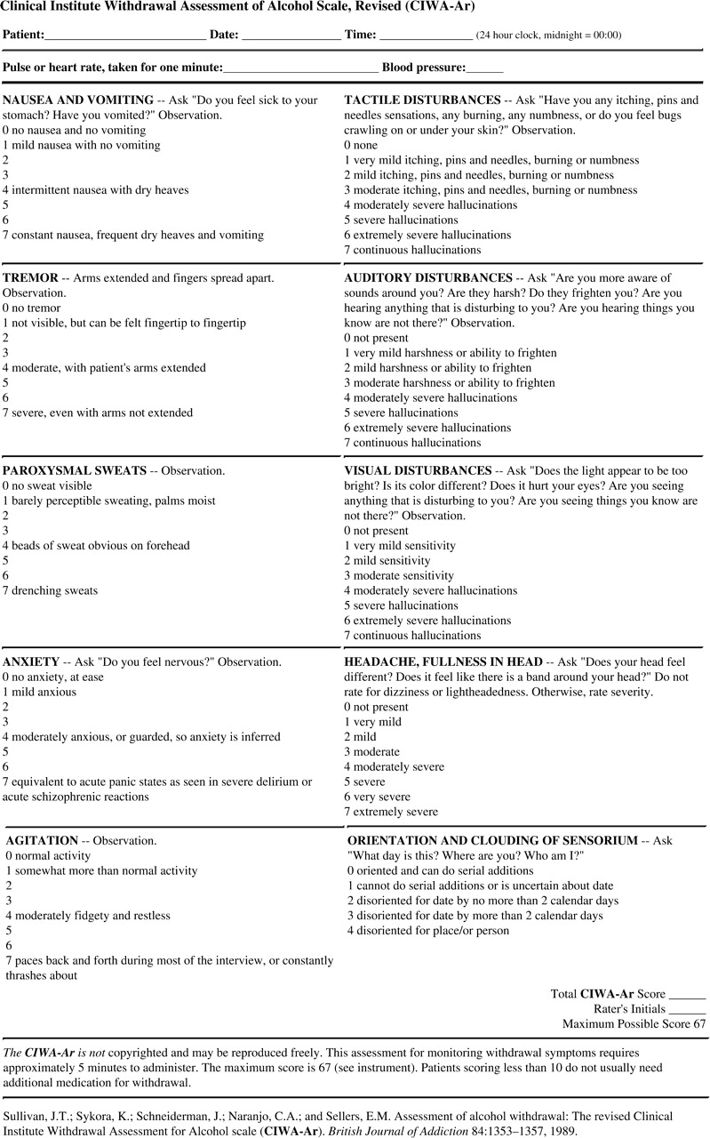

Slide 43
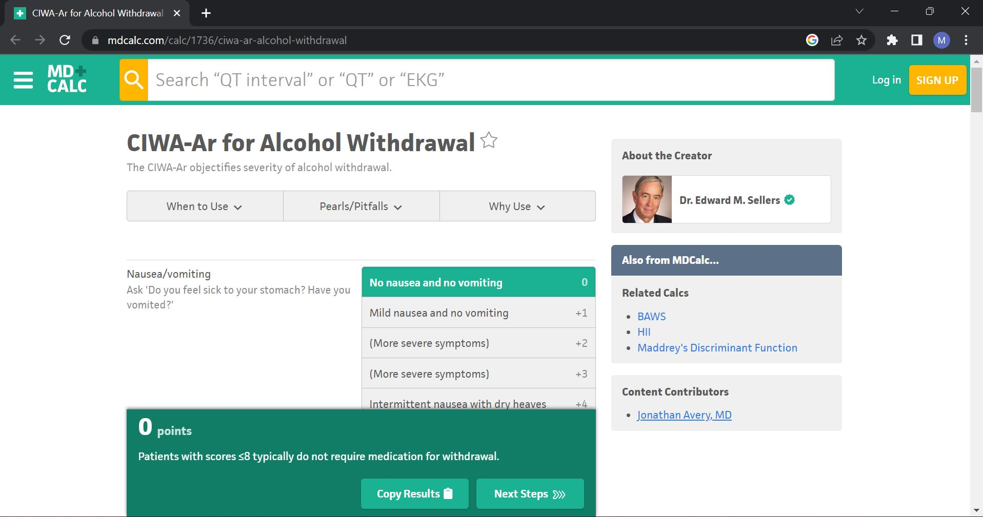

Slide 45
Early Liver Transplantation
Traditionally, patients with severe forms of alcohol-associated hepatitis who did not have a response to medical therapy were ineligible for salvage liver transplantation owing to the lack of a minimum period of sobriety

Slide 46
Early Liver Transplantation
In 2011, a landmark Franco–Belgian study represented a paradigm shift in the management of these patients’ care.
A total of 26 carefully selected patients with severe alcohol-associated hepatitis who had not had a response to glucocorticoids underwent early liver transplantation.
The cumulative 6-month survival was much higher among patients who received early liver transplantation than that in a historical series of patients with similarly severe disease (77% vs. 23%)

Slide 47
Early Liver Transplantation
Follow-up studies, including the American Consortium study, have confirmed the benefits of early liver transplantation in selected patients with severe alcohol- associated hepatitis
Recent follow-up study from the Franco–Belgian group showed that the 2-year survival was similar in the early-transplantation group and the standard transplantation group.

Slide 49
Early Liver Transplantation
The main concern of this approach is the potential for a high incidence of alcohol relapse.
Studies in both the European and American cohorts have shown a higher incidence of relapse than among other transplant recipients with advanced ALD (20 to 35% in the early-transplantation groups, as compared with 10 to 25% in the standard transplantation groups)

Slide 50
Early Liver Transplantation
Although sustained alcohol use after early transplantation is infrequent (10% at 1 year and nearly 20% at 3 years), it is associated with increased mortality.
Identifying risk factors for poor outcomes after liver transplantation is key in the selection process.

Slide 51
Early Liver Transplantation
Sustained Alcohol Use Post–Liver Transplant (SALT) score.
The SALT score includes four variables:
  More than 10 drinks/day at the time of the initial hospitalization
  Multiple previous rehabilitation attempts
  Previous alcohol-related legal issues
  Previous illicit substance abuse.
  There have been efforts to develop new predictive scores, including with the use of artificial intelligence

Slide 52
Early Liver Transplantation
Because excessive consumption of alcohol is heavily influenced by genetic, cultural, and socioeconomic factors, it is plausible that factors predicting relapse vary among different cultures across the globe
Thus, efforts to decrease the stigma and selection bias regardless of the cause of liver disease are needed

Slide 54
Early Liver Transplantation
It is important to consider that currently most patients with alcohol-associated hepatitis never get referred for liver transplantation, and it is very likely that stigma plays a part in this phenomenon.
An increasing number of studies have shown that patients with ALD are more likely to be denied placement on the transplant waiting list than those with non–alcohol-related liver disease who undergo evaluation, even though patients with ALD have higher MELD scores

Slide 55
Emerging Therapies
Most studies are aimed at
Promoting effective liver regeneration
Blocking inflammatory pathways
Restoring a normal microbiome
Combination of these

Slide 56
Emerging Therapies
Pilot study of a recombinant fusion protein of human interleukin-22, an anti inflammatory and pro regenerative cytokine, showed favorable outcomes as determined by Lille and MELD scores, a reduction in markers of inflammation, and increased expression of markers of hepatic regeneration

Slide 57
Emerging Therapies
Two randomized trials comparing G-CSF plus standard medical therapy with standard medical therapy alone in patients with severe alcohol-associated hepatitis showed an improvement in 3 and 6 month survival and a lower incidence of bacterial infections.
A more recent European study, however, failed to show a benefit with G-CSF in patients with severe alcohol-associated hepatitis.

Slide 58
Emerging Therapies
The role of gut microbiota in the pathogenesis of alcohol-associated hepatitis is another area of development.
A promising pilot study showed that fecal microbiome transplantation from healthy donors was associated with lower mortality than in a historical cohort

Slide 59
Emerging Therapies
A study of interleukin-1 inhibition by anakinra, pentoxifylline, and zinc showed an acceptable side-effect profile, but 180-day survival did not differ significantly between the combination therapy and glucocorticoid therapy

Slide 60
Emerging Therapies
Several clinical trials are now examining the role of probiotics and rifaximin in patients with alcohol-associated hepatitis.

Slide 61
Emerging Therapies
Other targeted trials under way involve the use of:
Anti-inflammatory drugs (interleukin-1β inhibition by canakinumab)
Drugs targeting gut–liver axis dysfunction and dysbiosis (broad-spectrum antibiotics and bovine colostrum)
Antioxidants (N-acetylcysteine, metadoxine, and n–5 fatty acids)
Drugs targeting apoptosis (selonsertib and emricasan)
Phage therapy
Supplemental nutrition strategies

